Slide 1

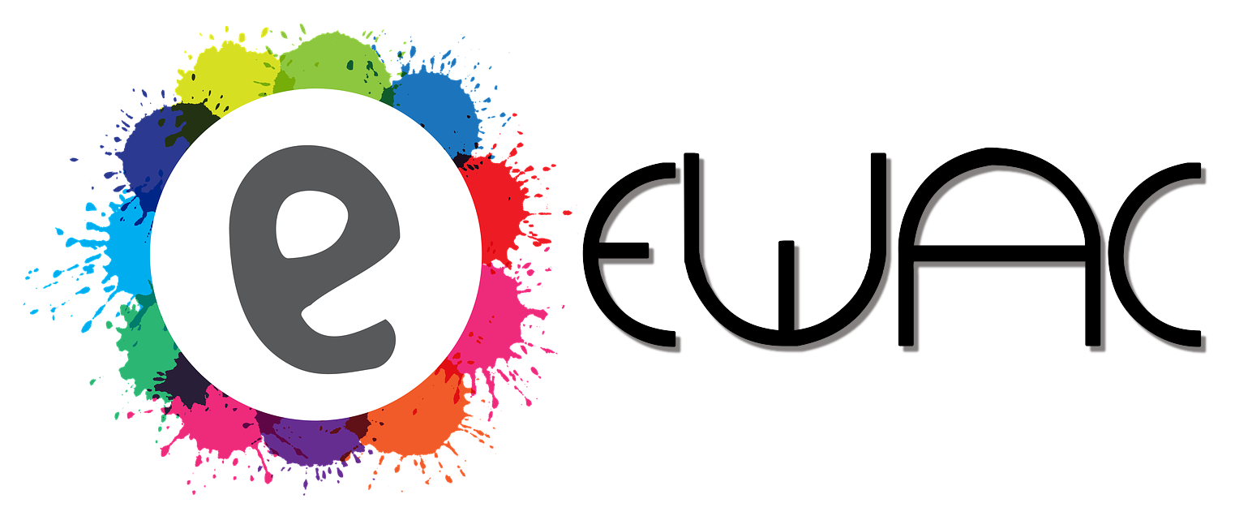
event web App creator
NATIVITY
By: Arjun dhawan ,rohan wadhawan ,Tanuj drall

Slide 2
Introduction
Our Aim is to create a website where events and its participants come together. This website will empower societies and organisations to create websites for upcoming events and at the same time allow users signed up with us to know about the events. This gives the organisation complete control over the website without involving third parties. The progressive component of our web app will ensure that notifications about upcoming events reach all our users, so that no willing participant is left out.

Slide 3
Motivation
The motivation behind our idea is making creation of event websites a ‘Cakewalk’ ​and spreading awareness about them. This can be achieved through understanding the key concepts namely Event Marketing Timeline​, Online Community Building ​and Progressive Web ​Application​. Finally, who doesn’t want to create a website on the fly without learning the required coding skills.

Slide 4
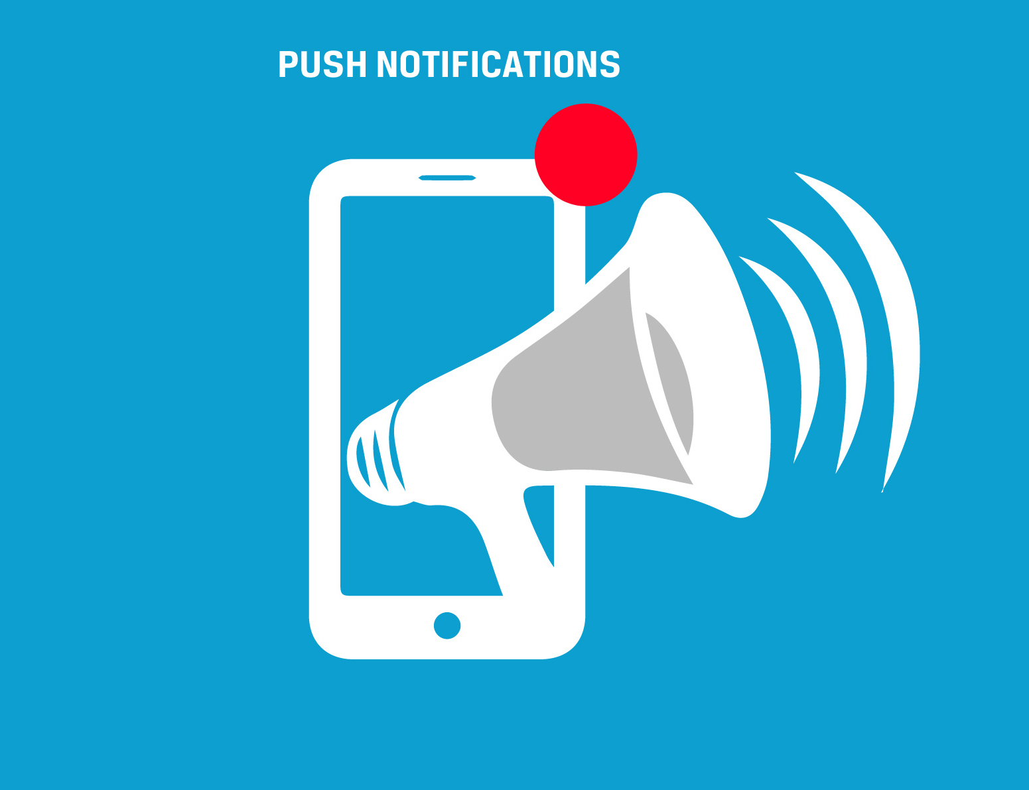
Problems we discovered
Lack of notifications or awareness :Social media platforms like Whatsapp groups or Facebook pages are indeed helpful in spreading awareness but their coverage is limited. Through our website, we want to overcome this issue as every user signed up with us will know about each event irrespective of his or her stream, who knows what might interest someone

Slide 5
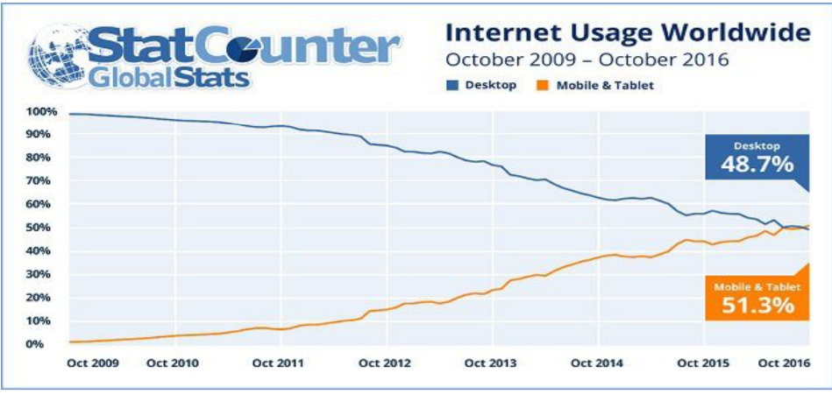
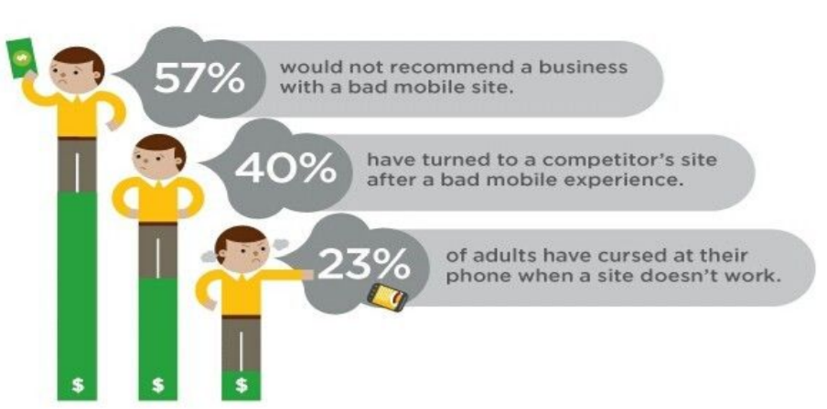
Sites could have been more user friendly and interactive and better mobile supported.
Coming to events, the following study shows how participation increases with an user-friendly and interactive website and multiplies even further if there is a mobile version to supplement it.

Slide 6
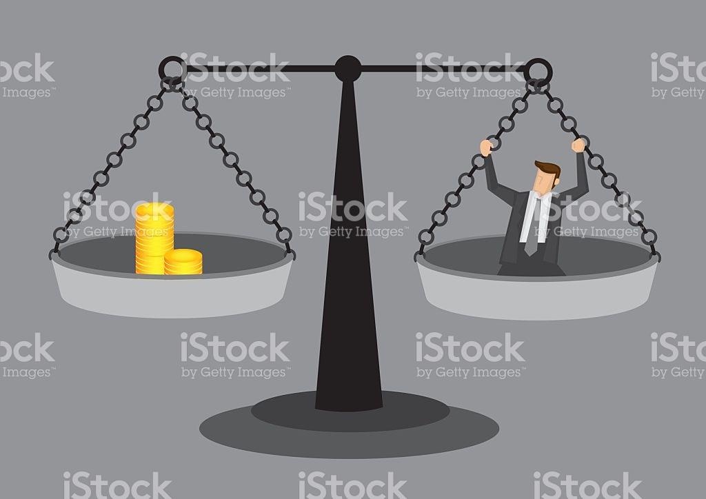

Why our product is NEEDED ?
Normally developing mobile websites which are responsive and have good illustrations is difficult and a time consuming job.
While doing so not only consumes a lot of time ,but also a lot of human and monetary resources . As such it is very a complicated process that not everybody can devote a lot of time and money towards.
Also such a web application is not often made because , instead of spending a lot of resource toward such a project ,we often take social media platforms as alternatives to do such a task.

Slide 7
SOCial NETWORk Platforms vs Our Product (why our product is better ?)
But social media platforms while can help in community building but in spheres such as education , there are a lot of disadvantages in doing so:
There a lot of unwanted and unrelated matter in there sites , hence for getting a piece of useful information we have to often scout it and filter out a lot of unrelated matter. Hence often the information that we are spreading does not reach the audience we are catering , creating a lack of awareness.
Have a lot of unrelated matter while searching for a particular piece of education related matter often creates a lot of distraction. Which in turn may lead our thoughts to a totally different tangent forgetting our original motive.

Slide 8
But our product people a progressive web platform for registering their own community. Doing so the time and resources taken for building such a platform is eliminated and all the benefit of pwa is given without much cost. Hence the third party involvement in these thing is also reduced .
People get an educational community which doesn’t have unrelated stuff that is present in the social networking websites.
It has easy and friendly UI which will increase the interest of the users.

Slide 9

Problems we are targeting
We are targeting three main problems, they are :
Making creation of Pre-Event and Event websites easy .
Creating an Online Community of Organisations and People.
Making a Progressive Web Application which provides a Native Mobile Application experience. Further more using IONIC Framework to give us a good mobile application.

Slide 10
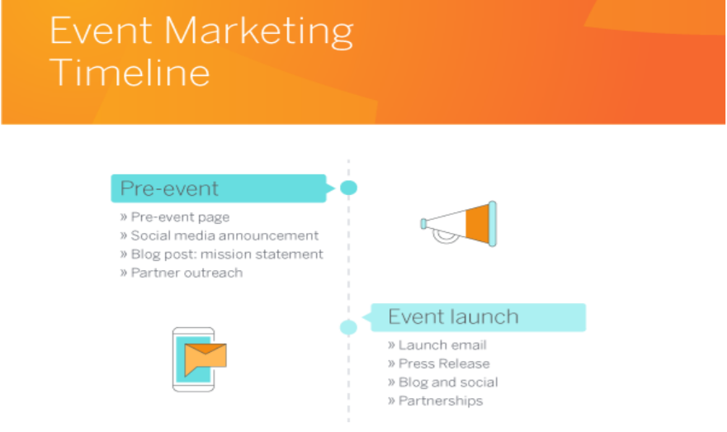
A. Event Marketing Timeline :
Pre-event website is as important as an event website. By creating a pre-event page, you can have a central page to drive people to, use it to capture leads and early interest (which can then be contacted later) and it will help build up your SEO authority with Google.

Slide 11
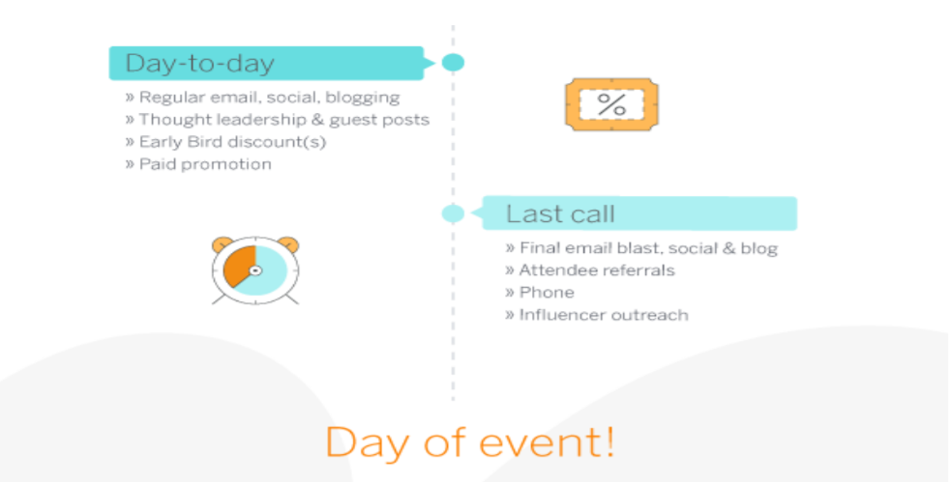
With our website, the organisations can create event websites for themselves just by filling a form and dragging and dropping the items they want on their website. They can launch their website even when it is partially complete thereby capturing leads and early interest.

Slide 12
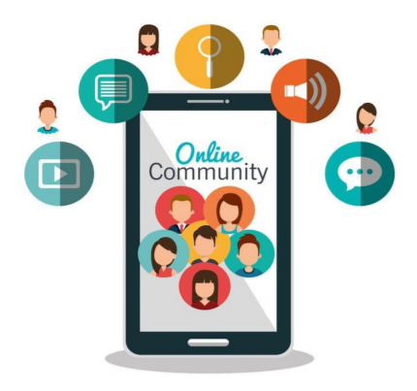
B. Online Community Building :
Like a customer is to business, a participant is to an event. Once a participant finds you, returning to that beautiful website of yours will be of decreasing interest to them. It’s not that the new developments about the event are no longer of interest to the participant, rather it’s just that they don’t want to make the effort of coming back to your website. Here comes the importance of a booming online community, as it will attract them back to your website.

Slide 13
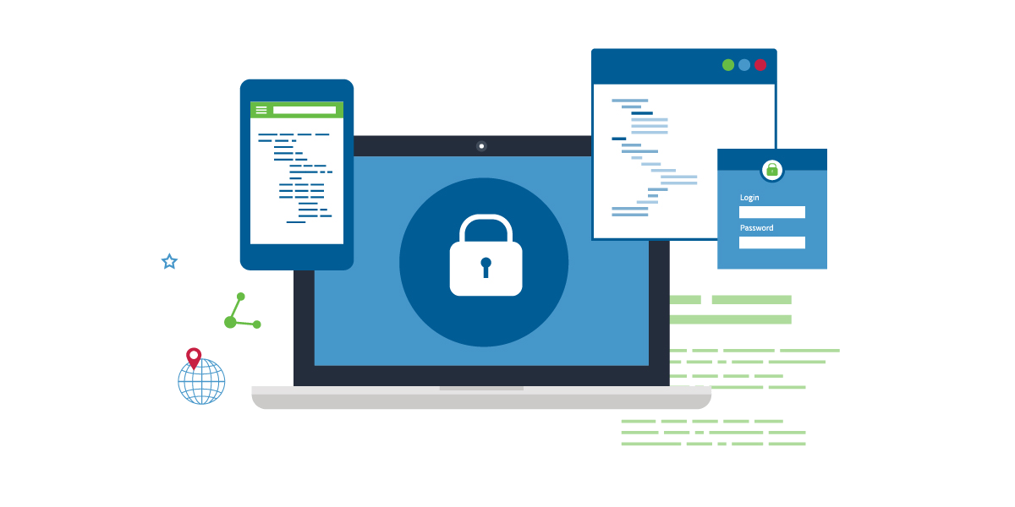
C. Progressive Web Application :
The Progressive Web Application or simply the PWA is new in the context of web development. It was launched by the Google a couple of years ago (in 2015). It was released and brought into the market with the intention of providing unmatched quality services as far as the mobile apps are concerned .
A Progressive Web Application uses modern web capabilities to deliver an app like user experience.
They evolve from pages in browser to immersive , top level apps , maintaining web’s low friction at every moment.

Slide 14
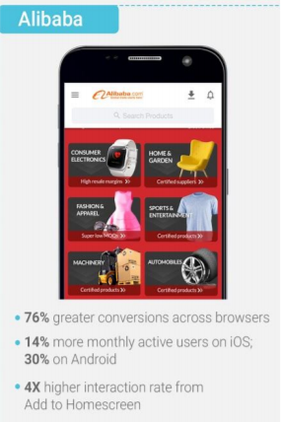
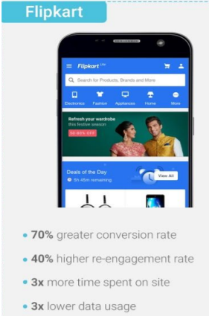
Benefits of progressive web appLication
One of the biggest advantages that PWA offers is low friction because it is a web based product. This means you don’t have to open the web page and the app separately.
The installation procedure is simple and you can add it into your home screen. It has greater potentiality to draw customers and therefore, is used by a number of corporate houses, like Alibaba’s PWA, Flipkart’s PWA, etc.

Slide 15
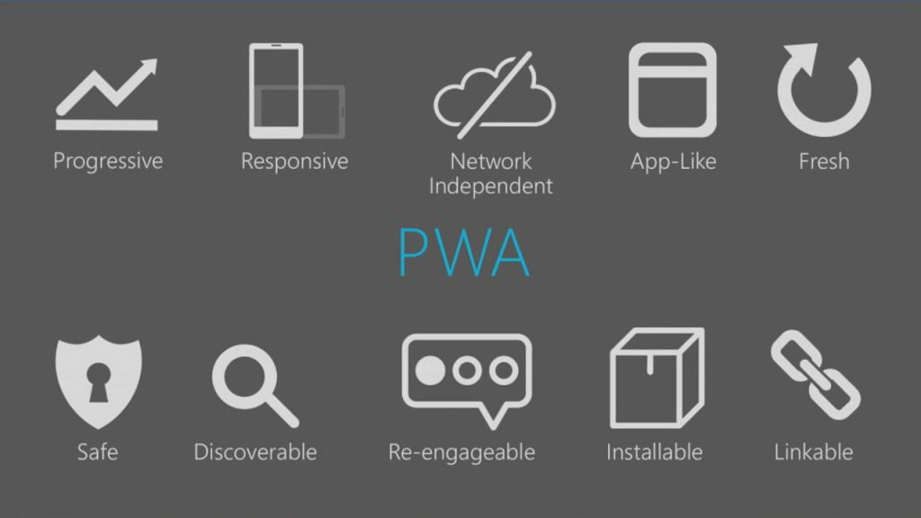
It always remains up-to date. If you are fixing bug or upgrading the version, then you have to update your app centrally unlike native apps where you need to submit the new version in app store. This means the users remain updated.
PWAs are comparatively much budget friendlier and quicker to develop in comparison to the native apps. It also supports multiple platforms. This feature is a blessing for the new business owners.

Slide 16
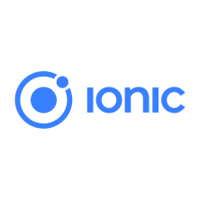
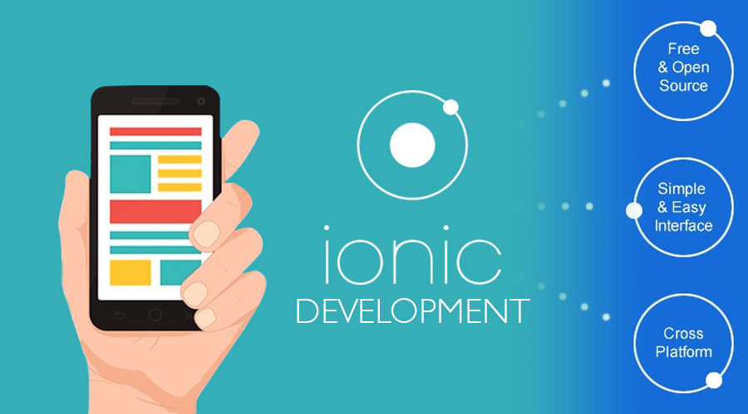
d. FRAMEWORK
Ionic is a complete open-source SDK for hybrid mobile appdevelopment.^{[4]} The original version was released in 2013 and built on top of AngularJS and Apache Cordova. The more recent releases, known as Ionic 2 or simply "Ionic", are built on Angular. Ionic provides tools and services for developing hybrid mobile apps using Web technologies like CSS, HTML5, and Sass. Apps can be built with these Web technologies and then distributed through native app stores to be installed on devices by leveraging Cordova .

Slide 17
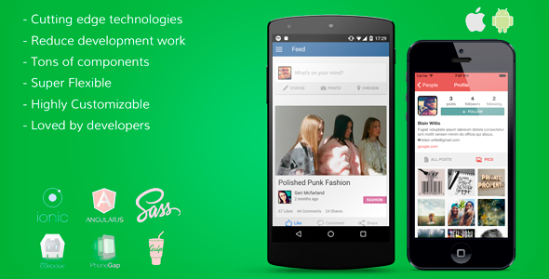
Advantages of ionic framework
One source for all the suported platforms (mainly Android and OSX).
Main development in html, css and js, which almost all web developers know (or at least the good ones ☺).
And being able to use great frameworks like angular, which is embedded in ionic by default.

Slide 18
Bibliography :
For graphs : https://www.augustash.com/our-blog/mobile-friendly-websites-2017
For PWA vs Native Application: https://www.mindinventory.com/blog/native-apps-vs-progressive-web-apps/
For Event Marketing Timeline: https://www.eventbrite.co.uk/blog/event-marketing-strategy-ds00/
For PWA examples : https://www.tigren.com/examples-progressive-web-apps-pwa/ and https://www.slideshare.net/protechman/progressive-web-apps-64791608

